Slide 1


TOUR MANAGEMENT
SYSTEM
UDAYKIRAN PALLANTI,
ASSOCIATE ENGR.

Slide 2
Project Overview
ASCENDION
T
M
S
Objective: To create a Tour Management System for managing hotels, guests, bookings, and reviews.
Key Features:
Admin authentication (Login page).
Manage hotels, guests, bookings, and reviews etc.
Dynamic and responsive user interface.
Modern design with Angular and Bootstrap integration.
Backend REST API with Spring Boot and MySQL database.

Slide 3
ASCENDION
Technologies Used:
Frontend:
Angular for component-based UI.
Bootstrap for styling and responsiveness and subheading
Backend:
Spring Boot for REST API services
MySQL as the database
Development Tools:
Postman for API testing.
Visual Studio Code for Angular development.
IntelliJ IDEA or Eclipse for backend development.

Slide 4
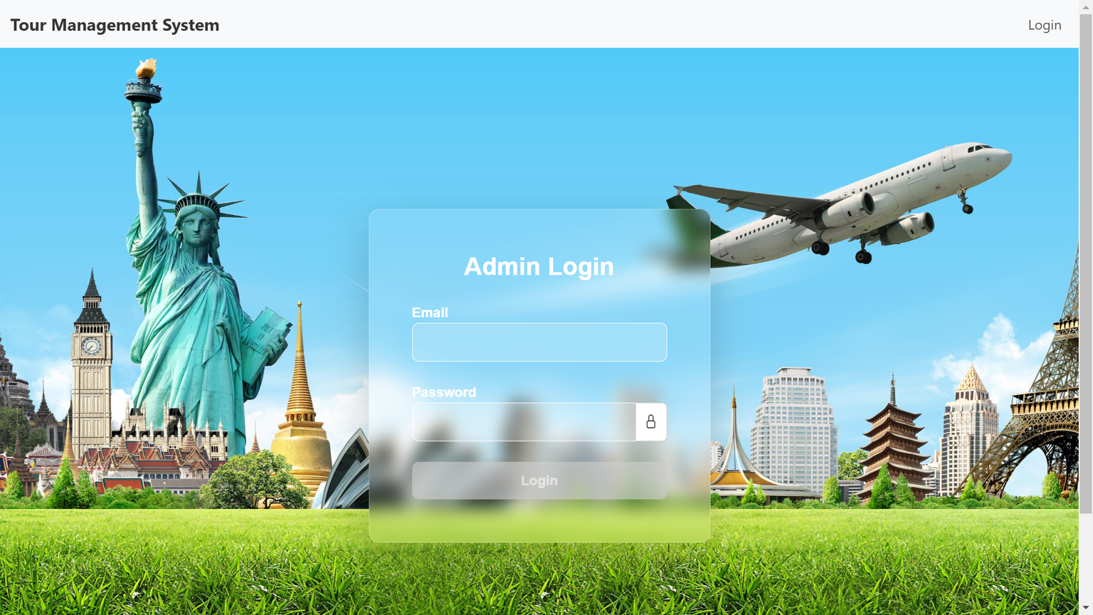
ASCENDION
Login Page
02
Features:-
Created a login form using Angular Reactive Forms.
Integrated client-side validation (e.g., required fields, email format validation).
Backend login endpoint for authentication.

Slide 5
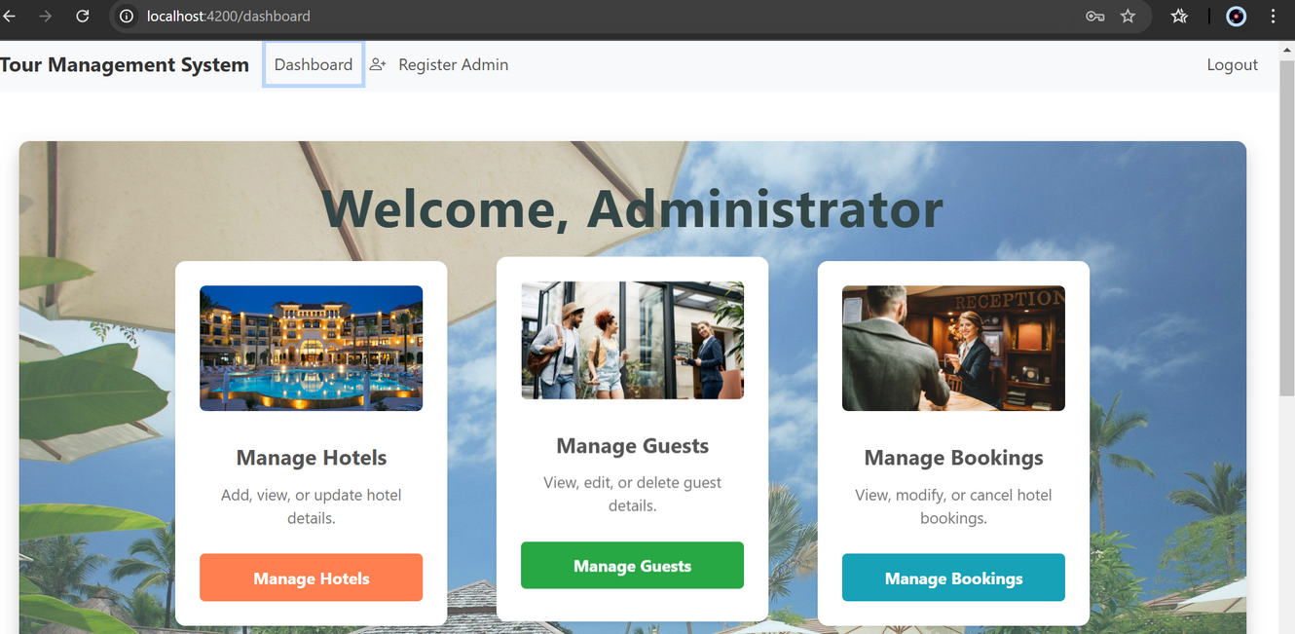
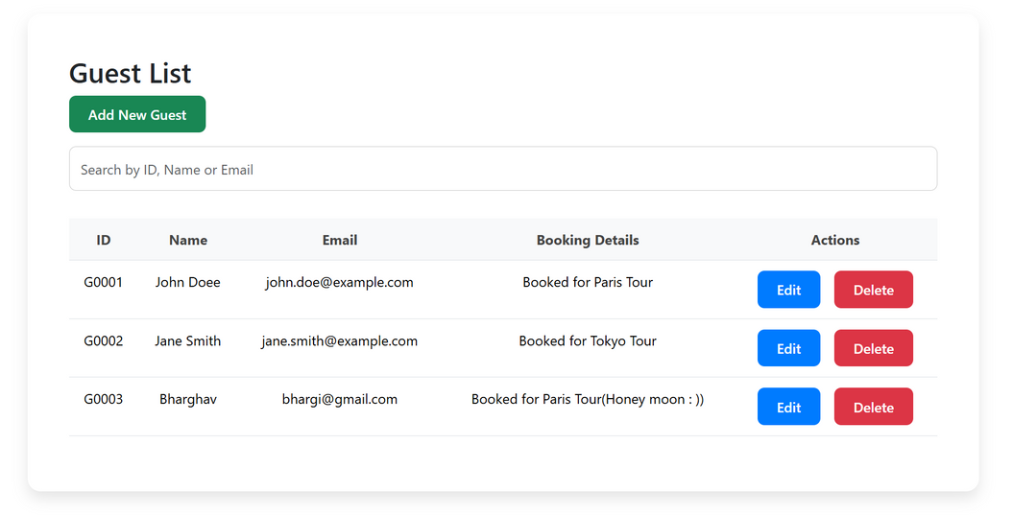
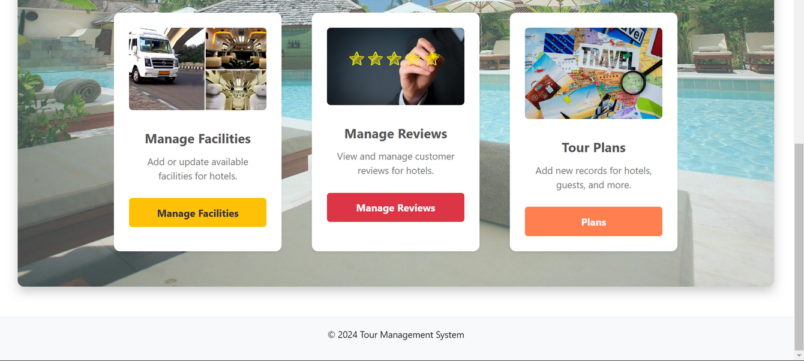
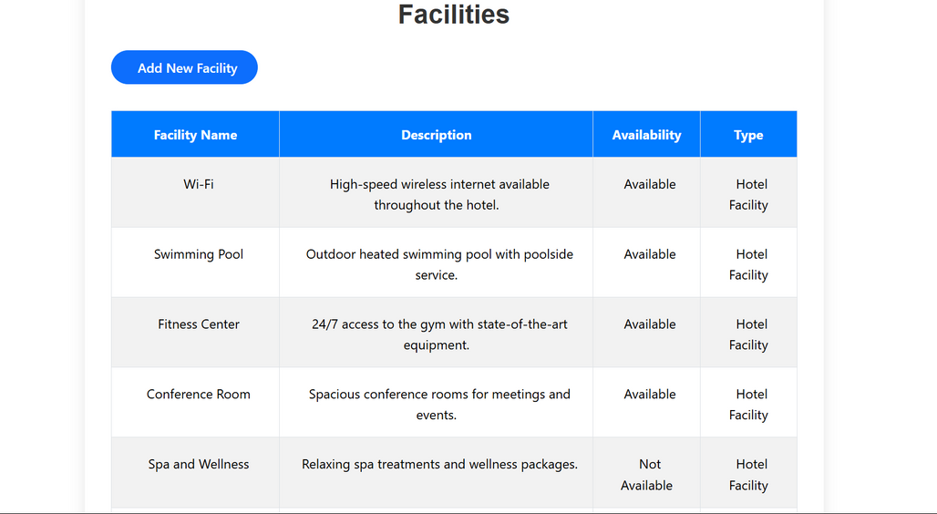
ASCENDION
DASHBOARD

Slide 6
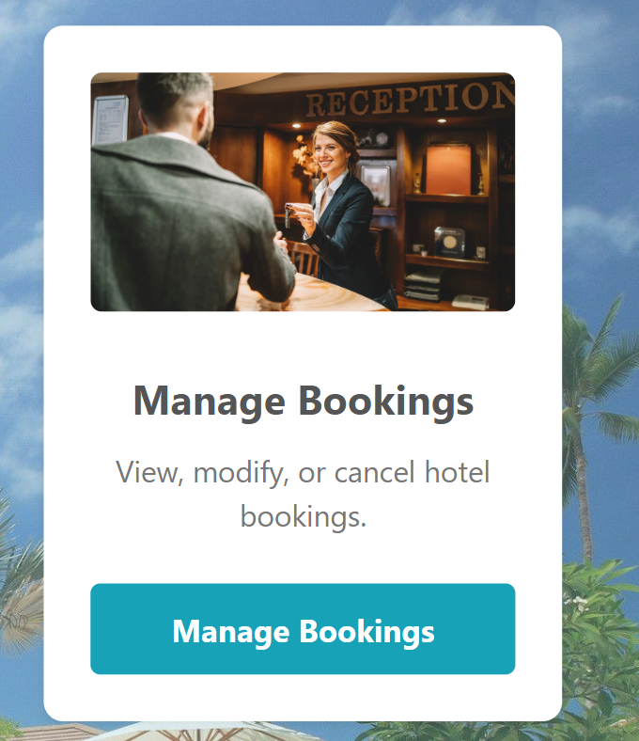
ASCENDION
Booking Component:
Booking form with dropdowns to select guests and hotels.
Displayed booking details in a structured table.
Validation for dates and hotel selection.
01
Challenges:
02
Fixed data mismatch issues between dropdown values and database.
Improved UX for date pickers and dropdowns.

Slide 7
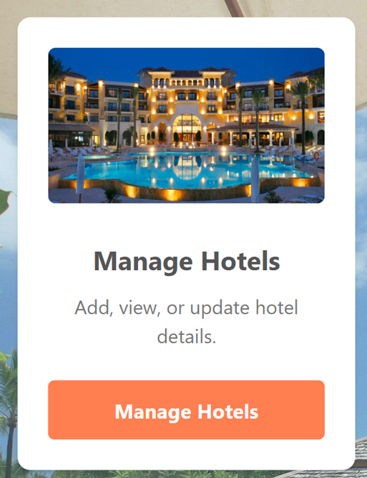
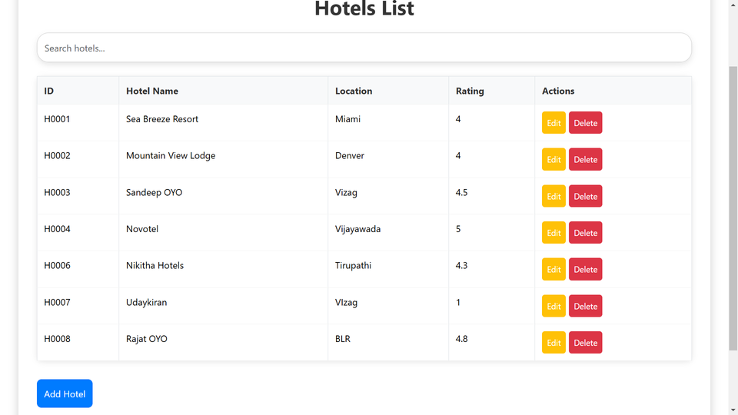
ASCENDION
Hotel Component
Features:-
CRUD operations (Create, Read, Update, Delete) for hotels.
Dynamic data fetched from the backend.
Styled the hotel table using Bootstrap.
03
Challenges & Solutions:-
Debugged API integration issues (fixed incorrect URL paths).
Improved table responsiveness using media queries.

Slide 8
ASCENDION
Backend API
Technologies: Spring Boot, MySQL
Features:
Designed RESTful APIs for Hotels, Guests, Bookings, and Reviews.
Implemented CRUD operations in the backend.
Secured endpoints for authentication and role-based access control.
Database:-
Tables for register, booking etc.
Backend integrated with a relational database.
Admin: For storing user credentials (username, password, role).
Hotels: Contains hotel information (name, location)
Guests: Stores guest details (name, contact, preferences).

Slide 9
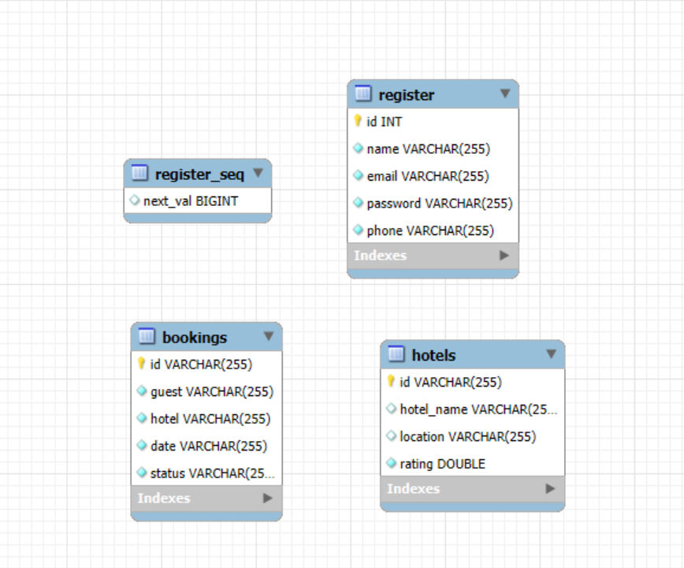
ASCENDION
ER Diagram:

Slide 10
Challenges &
Solutions
ASCENDION
Debugging form validation errors (e.g., reactive form bindings).
API integration issues (incorrect URLs, (e.g., /api/bookings vs. /bookings).
CSS conflicts between Bootstrap and custom styles.
Key
Challenges:-
Solutions:-
Systematic debugging using browser DevTools.
Testing REST APIs with Postman.
Modularized CSS to avoid conflicts.

Slide 11

SCENDION
THANK YOU

